Slide 1
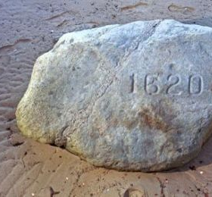
400 Years Passed from Old to New Testaments, about same amount of time from Pilgrims until now!

Slide 2
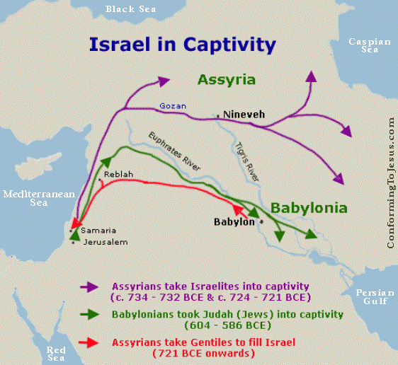

Slide 3
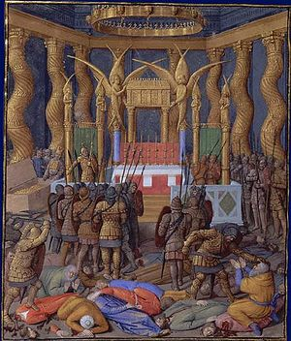
Desecration of Temple by Pompey in 63 BC.

Slide 4
Jesus was the Authority for NT scriptures.

Slide 5
⁴² They devoted themselves to the apostles’ teaching and to fellowship, to the breaking of bread and to prayer.⁴³ Everyone was filled with awe at the many wonders and signs performed by the apostles. ⁴⁴ All the believers were together and had everything in common.
Acts 2:42-44

Slide 6
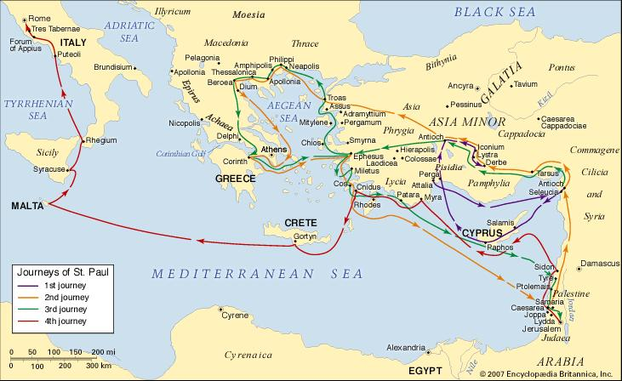
Growth of the Church caused the influence of the Apostles’ teachings and letters to expand their reach.

Slide 7
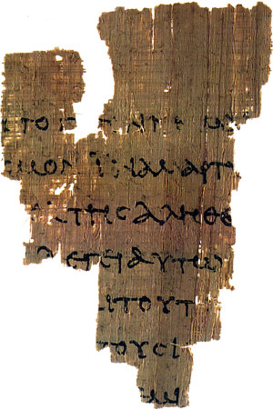
Papyrus 52, Oldest confirmed Biblical Manuscipt. Approx 150 AD

Slide 8
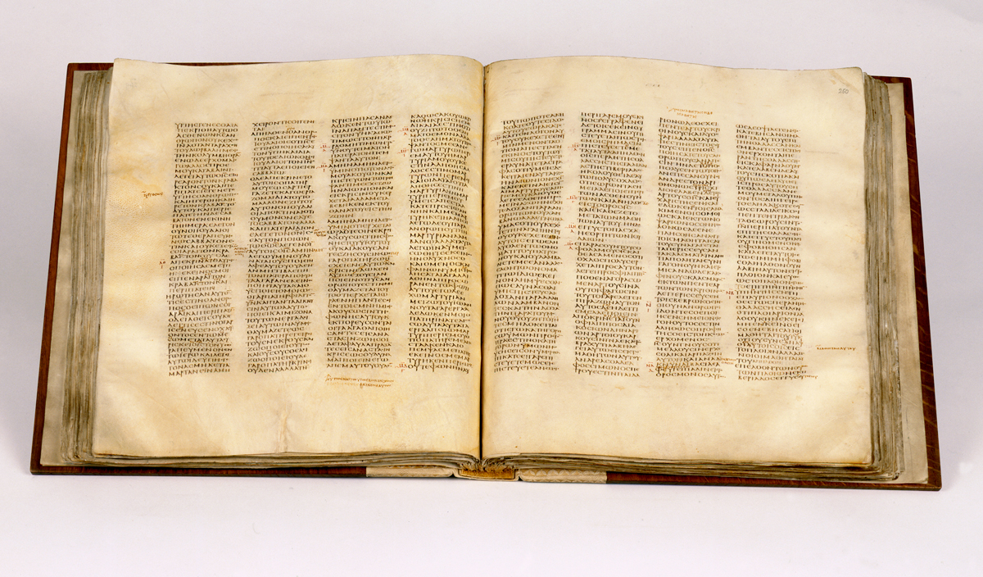
Codex Sinaiticus

