Slide 1
HOW SATAN TRIED TO DESTROY THE CHURCH Part 1

Slide 2
Destroy the CHRIST, destroy the CHURCH
At his birth: Matthew 2:1-16, Revelation 12:1-4
At the cross: Luke 23:44-46
DISCIPLES RESPOND: Acts 2:22-24, 36-41

Slide 3
Acts 2 - POVERTY
FROM 50,000 TO SEVERAL 100,000
DISCIPLES RESPOND: ACTS 2:42-47, ACTS 4:32-36

Slide 4
Acts 4 - PERSECUTION
Leaders imprisoned
Way more intense in 7 (Stephen) and 8 (Great persecution)
Courage from being with Jesus
DISCIPLES RESPOND: ACTS 4:23-31 unity, prayer & boldness

Slide 5
Acts 5 - HYPOCRISY
Lied to the Holy Spirit & God
An unholy secret
God’s punishes - teaches a lesson to others
DISCIPLES RESPOND: Great fear! Take sin seriously!

Slide 6
Acts 6 – RACIAL DIVISION
Grecian (Hellenists) Jews at odds with Hebraic Jews
4-5 years and maybe 20,000 converts
Complained is actually “murmuring”
An unintentional oversight
DISCIPLES RESPOND: Gather, listen, explain, approve!

Slide 7
Acts 9 – A SUSPICIOUS NEW CONVERT
From Saul to Paul, his conversion (recounted in Acts 22)
People doubted WITH GOOD REASON
DISCIPLES RESPOND: Accept, protect and assist

Slide 8
These ACCOUNTS are here to TRAIN US!
Learn Satan’s tactics
Avoid the traps
Protect the church
Defeat Satan in your life

Slide 10
HOW SATAN TRIED TO DESTROY THE CHURCH Part 2

Slide 11
These ACCOUNTS are here to TRAIN US!
LEARN
Satan’s tactics
AVOID
the traps
PROTECT
the church
DEFEAT
Satan in life

Slide 12
Review Acts 1-9
TACTIC
Kill the Christ
Poverty
Persecution
Racial tension
Suspicious convert
RESPONSE
People Repent / Baptized
People give generously
People pray, emboldened
People found solution
People forgive / accept

Slide 13
Conversion Confusion
A good man? (Acts 10)
A preacher? (Acts 18)
A group of disciples? (Acts 19)

Slide 14
3 Important QUESTIONS
Am I saved?
When was I saved?
How was I saved?

Slide 15
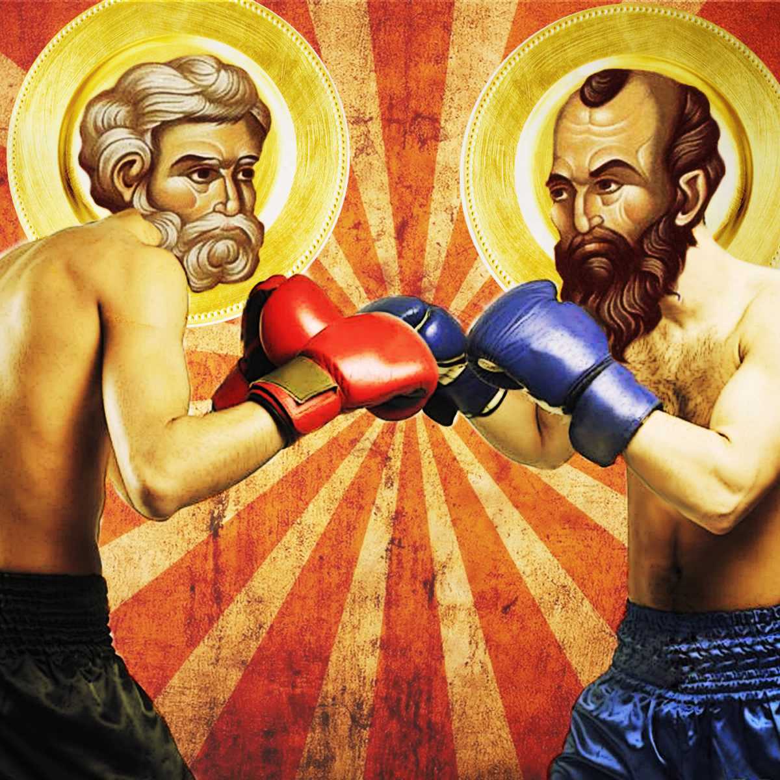
Acts 15 “a sharp disagreement”

Slide 16
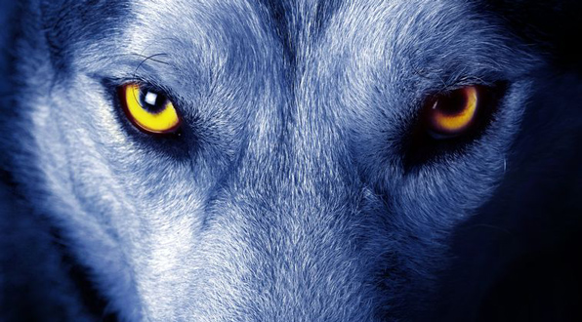
Acts 20 Attack the flock

Slide 17
Is there a forgotten message in ACTS?
2 about 3,000 baptized
4 We can’t help speaking about what we have seen and heard
6 The word of God spread, disciples increased rapidly
8 preached the word wherever they went
11 taught great numbers of people
13 the word of the Lord spread through the whole region
16 grew daily in numbers

Slide 18
Review Acts 10-28
TACTIC
Confusion on Conversion
Arguments among leaders
Attack the flock
Forget the message
RESPONSE
People Listened & Obeyed
People approved & waited
People watched & acted
People preached

