Slide 1
KINGDOM LIVING
A DISCIPLES PERSPECTIVE ON SOCIAL & POLITICAL ISSUES

Slide 2
This lesson IS NOT about:
RACE
RELIGION POLITICS
SOCIAL ISSUES

Slide 3
This lesson IS ENTIRELY about:
UNITY
PEACE
HARMONY
FOCUS
KINGDOM of GOD

Slide 4
MY WORLD
KINGDOM
Perspective
BEFORE
CONVERSION

Slide 5
MY WORLD
KINGDOM
Perspective
AT CONVERSION

Slide 6
MY WORLD
KINGDOM
Perspective -
MATURING
DISCIPLE

Slide 7
DIVIDING IS EASY

Slide 8
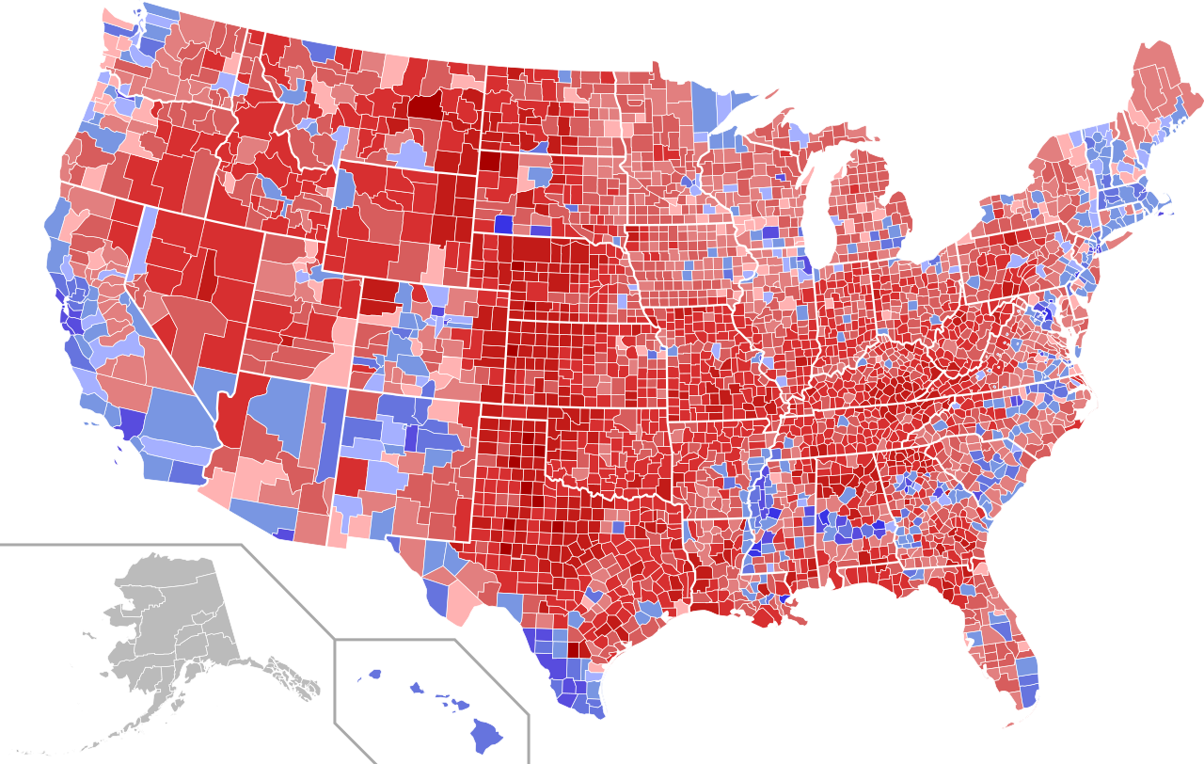
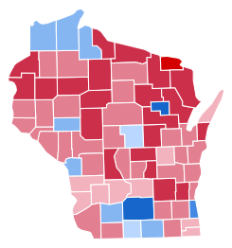
TO ILLUSTRATE THE POINT

Slide 9
HOT BUTTON
ABORTION: 62% pro life 32% pro choice
GAY MARRIAGE: 67% for 33% against
STRONGER GUN CONTROL: 49% yes 51% no
TERM LIMITS -CONGRESS: 86% yes 14% no
BORDER WALL: 55% yes 45% no
FUND SANCTUARY CITIES: 67% yes 33% no
AFFORDABLE CARE ACT: 56% against 44% for
RAISE TARIFFS ON IMPORTS: 43% yes 57% no
INCREASE REGS - CLIMATE: 62% yes 38% no
RELEASE NON-VIOLENT PRISONERS: 55% yes 45% no

Slide 10
Jesus Prays for All Believers John 17:20
“My prayer is not for them alone. I pray also for those who will believe in me through their message, ²¹ that all of them may be one, Father, just as you are in me and I am in you. May they also be in us so that the world may believe that you have sent me. ²² I have given them the glory that you gave me, that they may be one as we are one— ²³ I in them and you in me—so that they may be brought to complete unity. Then the world will know that you sent me and have loved them even as you have loved me.”

Slide 11
How to live out His prayer
FOUR

Slide 12
Imitators of God
FIVE 1-2

Slide 13
Two Procedures
PERSONAL ISSUES
Speak truthfully
Get help
CHURCH ISSUES
Speak to the right people
Authority: Ministry staff, Core group, HCL’s

