Slide 1

Milwaukee
Church of christ
September 9th, 2018

Slide 2
KINGDOM SERIES
KINGDOM DEFINED
KINGDOM INTERNALIZED
KINGDOM LIVING
KINGDOM TRAINING

Slide 3
An odd place to start sheep & goats?
Matthew 25:31-46

Slide 4
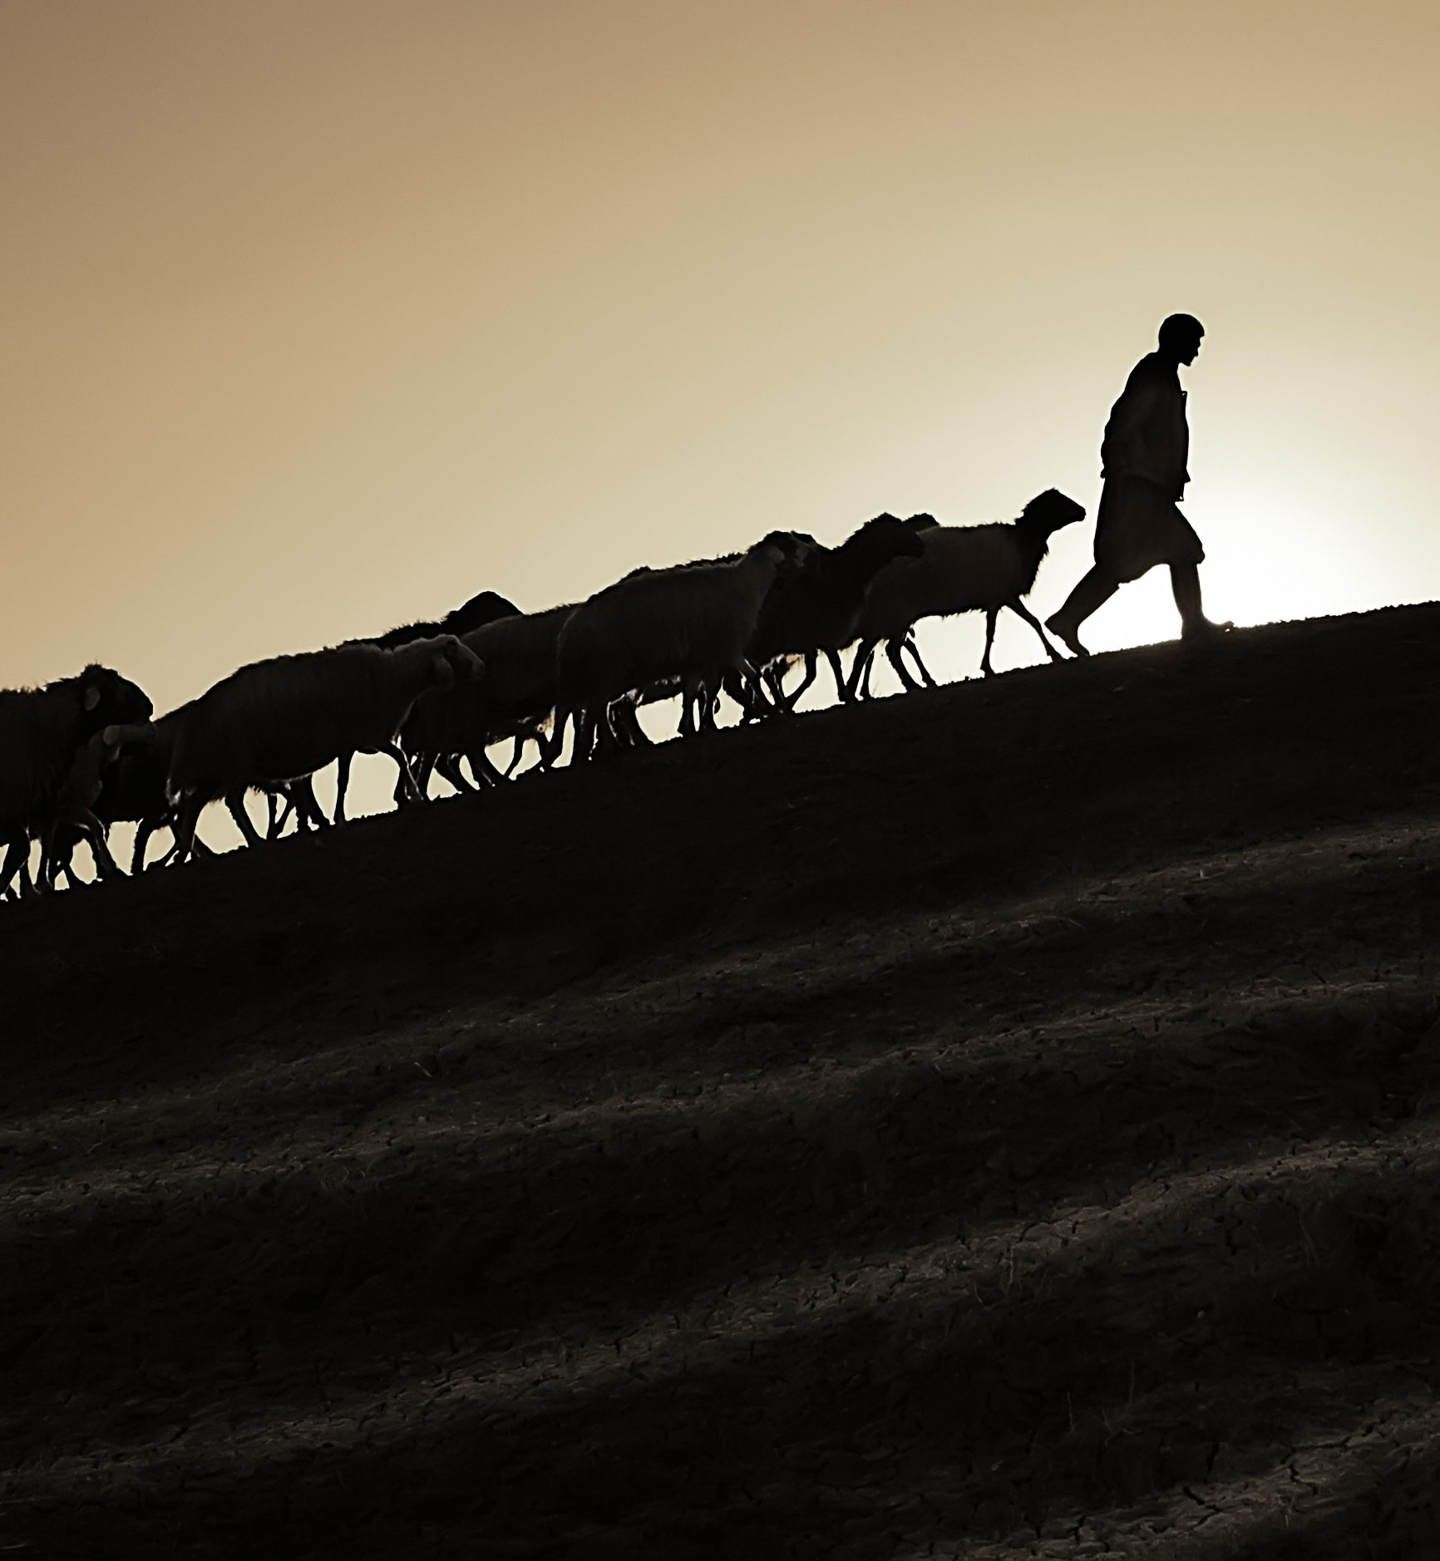
God designed us to be lead
IN LIFE
IN CHRIST
IN THE CHURCH

Slide 5
TRAINING
gymnázō (from gymnós)
"to train, naked or wearing a loin cloth" – to train with one's full effort, i.e. with complete physical, emotional force like when working out intensely in a gymnasium.
["Gym" and "gymnasium" come from this same root.]
gymnázō "exert intensely" presumes full discipline, necessary to be in "top working condition“. This is gained only from constant, rigorous training, acquiring proficiency through practice – regular exercise & coaching with graduated resistance
The physical and spiritual elements are included with us being in "God's gymnasium".
terms

Slide 6
Matthew 5:48
“be perfect therefore as your heavenly father is perfect”
2 Corinthians 13:11
“aim for perfection”
Colossians 1:28
“present everyone perfect in christ”
per·fec·tion
pərˈfekSH(ə)n/
the condition, state, or quality of being free or as free as possible from all flaws or defects.
the action or process of improving something until it is faultless or as faultless as possible.

Slide 7
“Give me ten men that hate nothing but sin , love nothing but god and we will change the world”
John Wesley

